Slide 1
Opening a Restaurant in Paris
Finding the best location

Slide 2
Introduction
Location is trivial when opening a restaurant
A shortlist of the best location can be found through data clustering
Understand the catering market in Paris is essential
The catering market differ from borough (arrondissement) to another and even from neighborhood to other
The analysis will be : which are the best neighborhood for opening a resultant knowing the population , farmer markets and events organized in the area.

Slide 3
Data Collection
The data used is open source :
https://opendata.paris.fr/pages/home/.
Borough and neighborhoods & Population
https://www.data.gouv.fr/fr/datasets/r/e88c6fda-1d09-42a0-a069-606d3259114e
Events :
https://opendata.paris.fr/explore/dataset/que-faire-a-paris-/export/?disjunctive.category&disjunctive.tags&disjunctive.address_zipcode&disjunctive.address_city&disjunctive.access_type&disjunctive.price_type&basemap=jawg.transports&location=7,47.73195,2.41324
Farmer markets
https://opendata.paris.fr/explore/dataset/marches-decouverts/download/?format=json&timezone=Europe/Berlin'

Slide 4
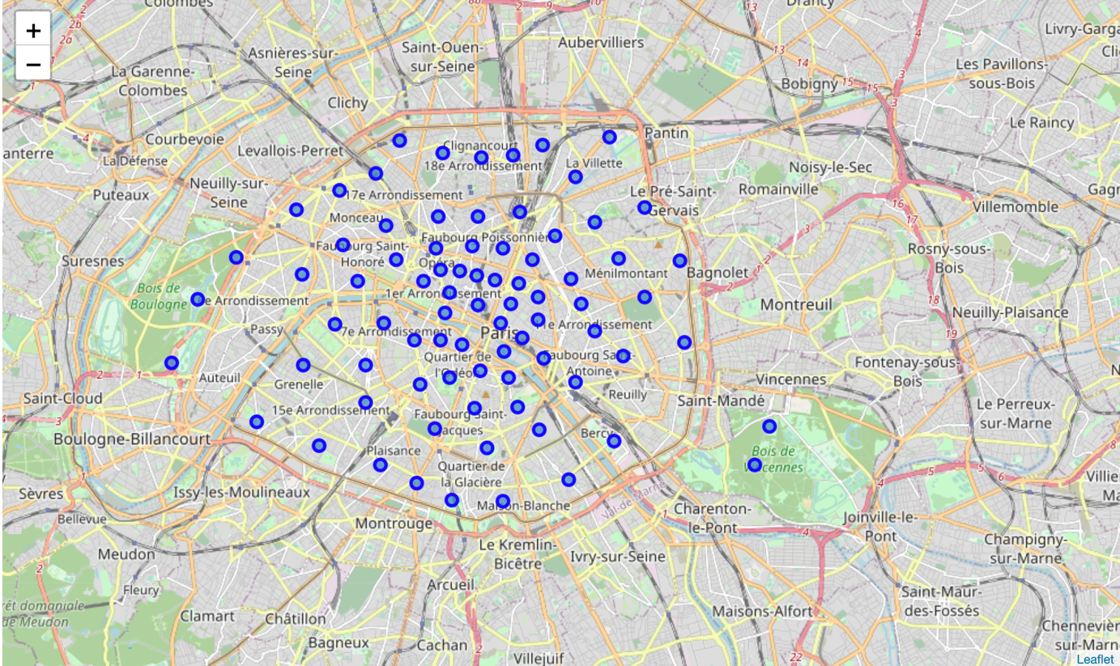
Analytic approach - Neighborhoods –
The set of Paris’ neighborhood
there is the center of Paris , the inner circle , and the outer circle or what we call ( the first crown).

Slide 5
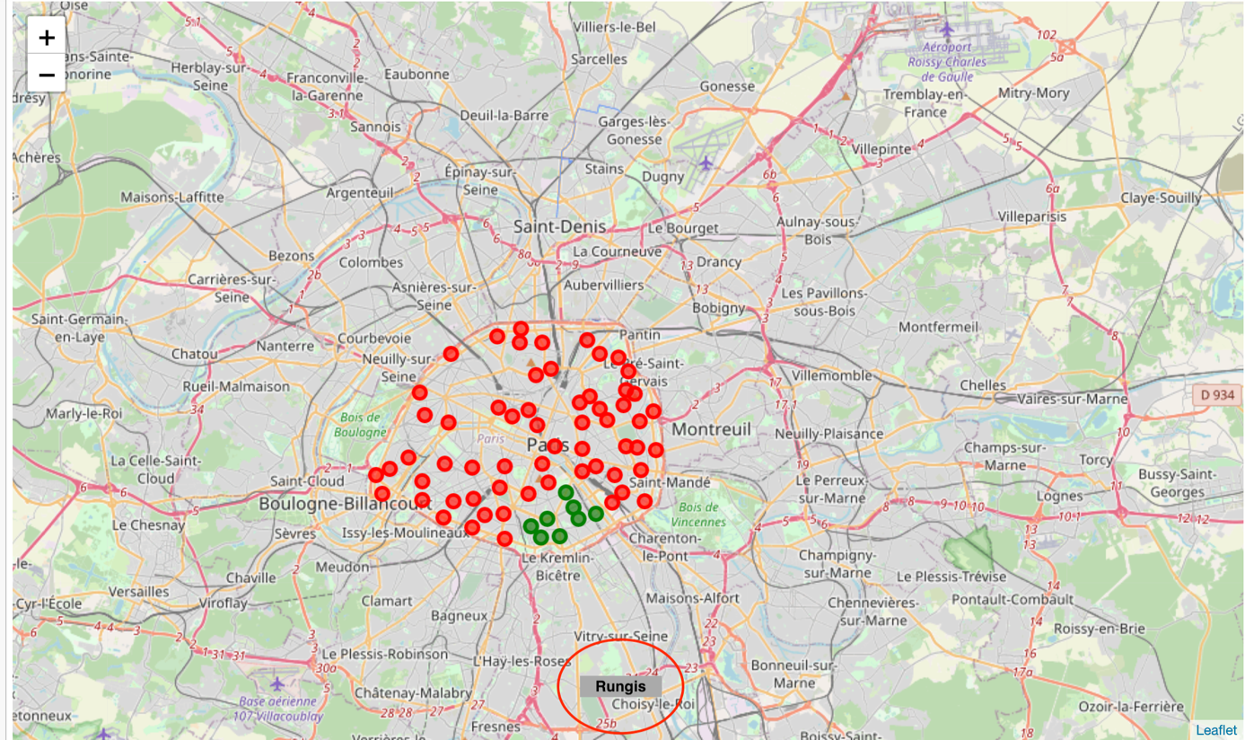
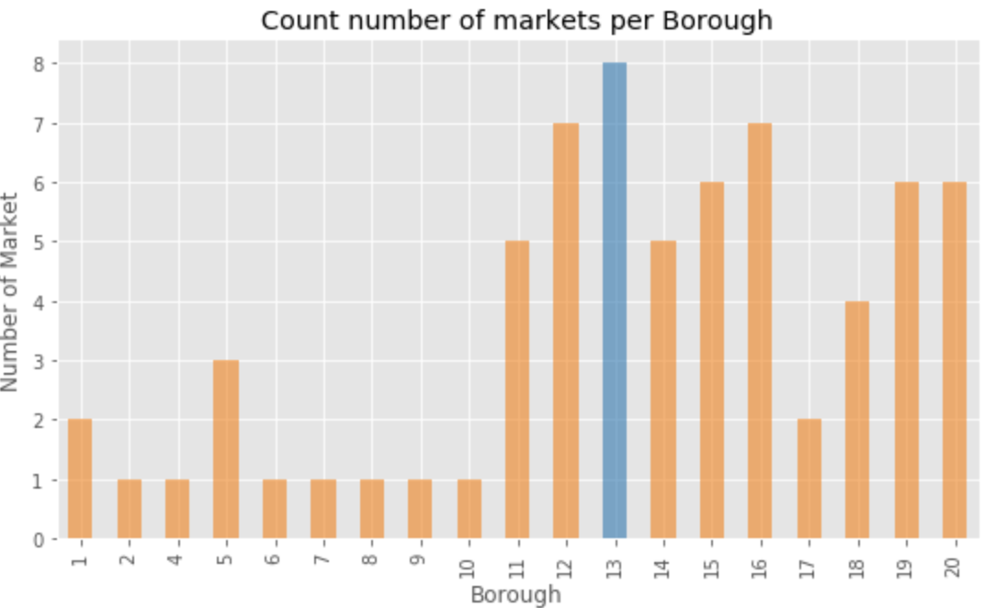
Analytic approach - Farmer markets –
Analyze the area where farmer market are more dominant
We can see that there is a high concentration on the 13th arrondissement. Actually it is the neared to Rungis market which might explain this observation. Rungis is one of the biggest market in Europe

Slide 6
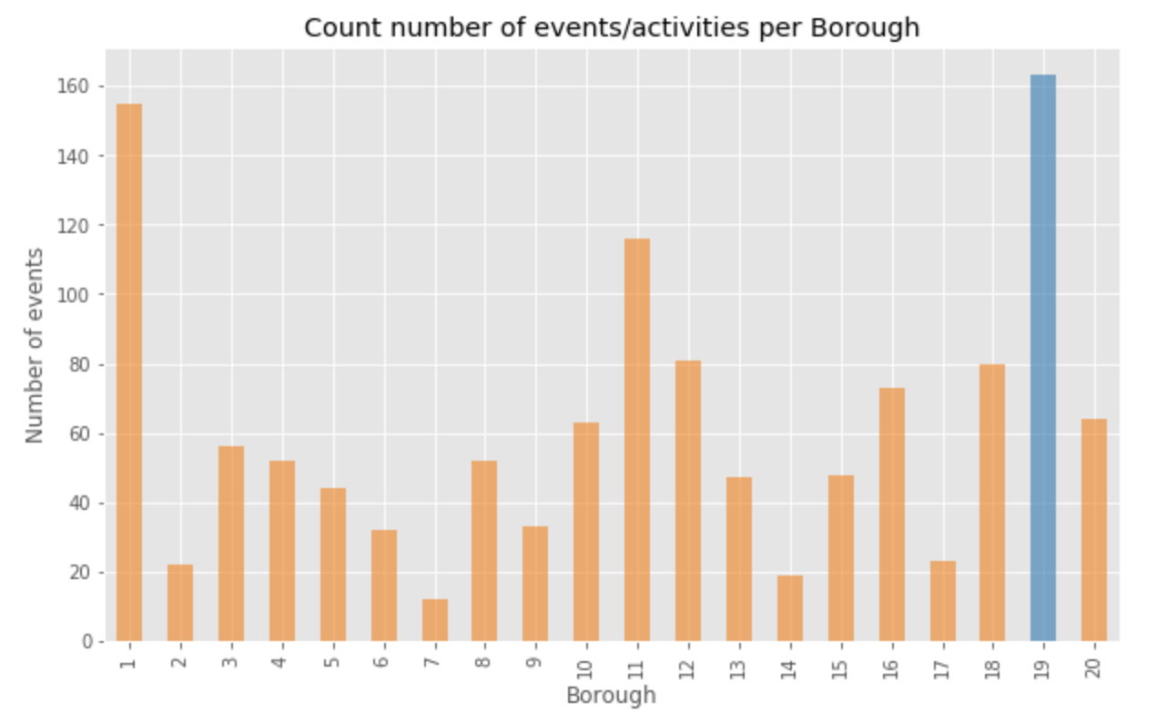
Analytic approach - Events/activities –
Much more events are organized in the 19th arrondissement.
As for the first conclusion, the density is on the outer circle , but in this case more on the north of Paris. We start sensing a certain trend

Slide 7
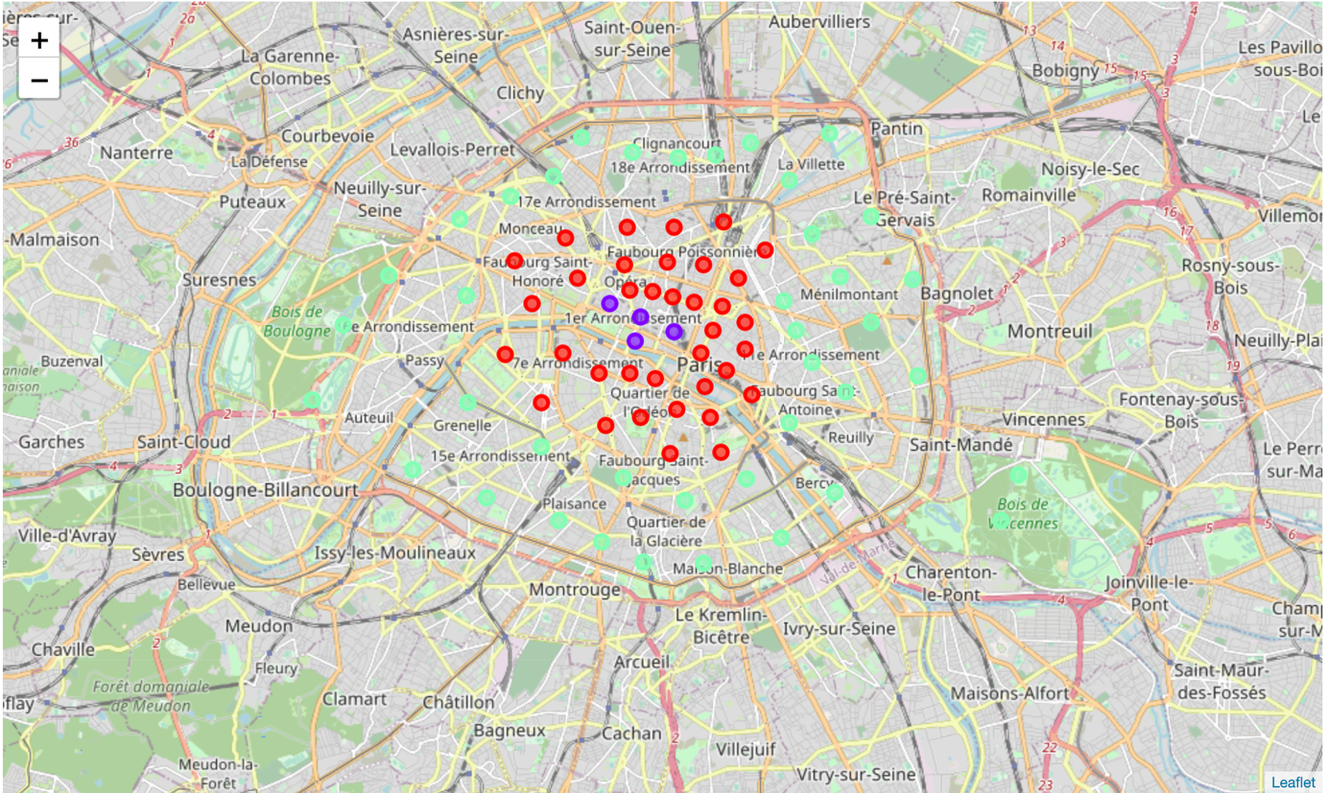
Results
Using k-means (3 clusters ) clustering algorithm we come to the following result
Cluster 0 is marked in red: This cluster unites the neighborhoods with the highest number of restaurant , but with a low number of markets and not a very significant number of events held during the year. Probably if we used the density of tourism , we would understand the high number of restaurant.
Cluster 1 is marked in purple : This cluster reflects low population , but very high event density. most people goes around these areas to attend event during the year , which might drive up the customer flow and hence increase the number of dishes served.
Cluster 2 is marked in purple : This cluster reflects a compromise between the three features. it is situated in area dense with population , adding the population movements coming for the events/activities and the advantages of having many markets. it seems it is the best areas to open a restaurant.

Slide 8
Conclusion & point of improvement
We can say that the idea of investing in restaurant is more interesting around Paris rather than in the center of Paris.
The main reason is that population boosted by the movement generated by events and other activities is situated around Paris.
The competition is too harsh in the center of Paris.
This is just a small analysis on the location choice , other aspects could be added to this analysis such as the purchasing power of the population
The model can be improved using more pinpoint data to our analysis

